Slide 1
Sentiment Analysis of Tweets on Apple and Google Products
A Non-Technical Overview
By: Group 3 | Phase 4 Project
JABES KOTIENO
IVET BUYAKI
CHRISTOPHER KATIMBWA

Slide 2

1. Business Understanding
Real-time Consumer Voice: Twitter isn't just social media; it's a massive, immediate feedback platform where users express honest opinions – good and bad – about products and services.
A Competitive Edge: In today's fast-paced market, consumer expectations are constantly shifting. Gaining timely insights into public sentiment isn't just useful; it's a critical competitive advantage.
Strategic Focus: Google & Apple: We're specifically targeting Google and Apple. As tech giants, they receive constant online attention, making their Twitter data a goldmine for understanding public mood and identifying areas of enthusiasm or dissatisfaction.
Driving Data-Driven Decisions: This project isn't just about collecting data; it's about transforming raw tweets into actionable insights that will inform crucial decisions across marketing, product development, and customer support.

Slide 3
2. Key Stakeholders & Their Interest
The Marketing Team: Tracking brand health & campaign impact.
Product Managers: Informing feature enhancements & product roadmaps.
Customer Support Team: Identifying & addressing common user complaints.
The Data Science Team: Building & maintaining the analysis model.
Executive Leadership: Guiding strategic decision-making & market positioning.
PR & Communications Teams: Monitoring public opinion & managing company image.

Slide 4
3. Project Objective
To develop an NLP model that can automatically classify Tweets about Apple and Google products as Positive, Negative, or Neutral.
This Proof of Concept aims to demonstrate how sentiment insights from social media can:
- Support marketing and brand management teams
- Inform customer service about recurring issues
- Alert product teams to common pain points or praised features

Slide 5
4. Business Questions
1. What proportion of Twitter sentiment is Positive, Negative, or Neutral for Apple vs Google products?
2. Which products are associated with the most Negative or Positive sentiment?
3. Are there recurring themes in Positive/Negative Tweets?
4. How well can an automated classifier predict sentiment based on Tweet content?

Slide 6
5. NLP Methodology
- Data cleaning and preprocessing
- Sentiment labeling (Positive, Negative, Neutral)
- Feature extraction using TF-IDF (Unigrams and N-grams)
- Classification models: Logistic Regression and XGBoost
- Addressing class imbalance with SMOTE
- Evaluation using F1-score, precision, recall, and confusion matrices

Slide 7
6. Key Findings
- Positive sentiment dominates most product categories
- iPhone has the highest proportion of Negative tweets
- Recurring themes:
• Positive: SXSW, app features, excitement
• Negative: design flaws, app crashes
- Binary classification had strong performance (F1 ≈ 0.91 positive, 0.59 negative)
- Multiclass classification struggled with Neutral and Negative detection

Slide 8
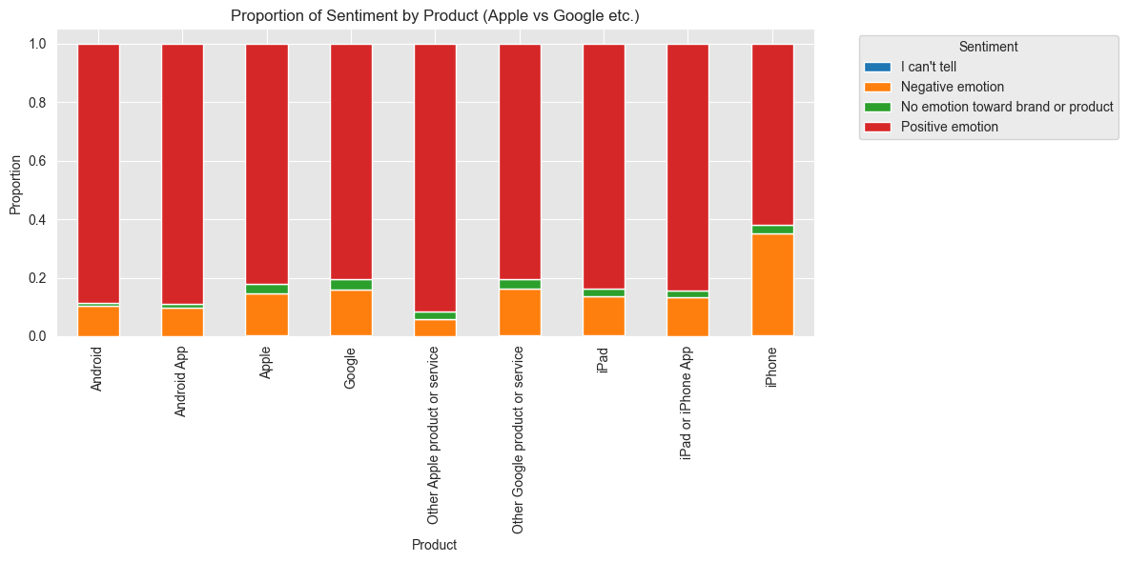
6.1 Proportion of Twitter sentiment for Apple vs Google products

Slide 9
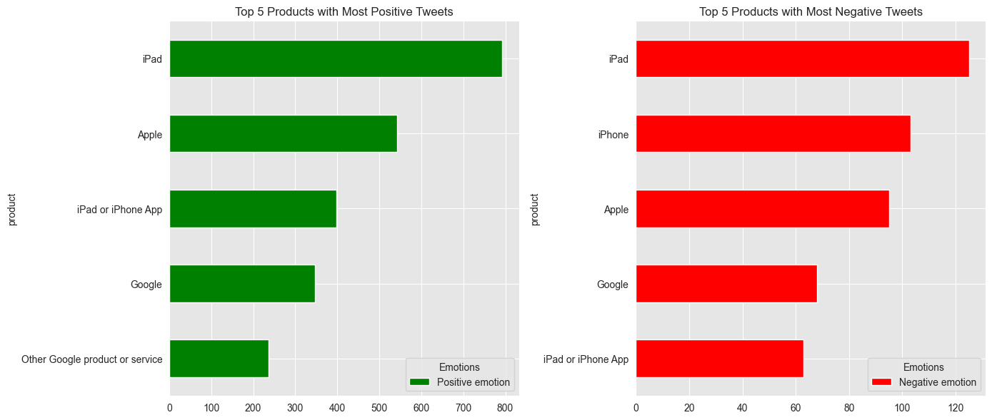
6.2 Products associated with the most negative or most positive sentiment

Slide 10
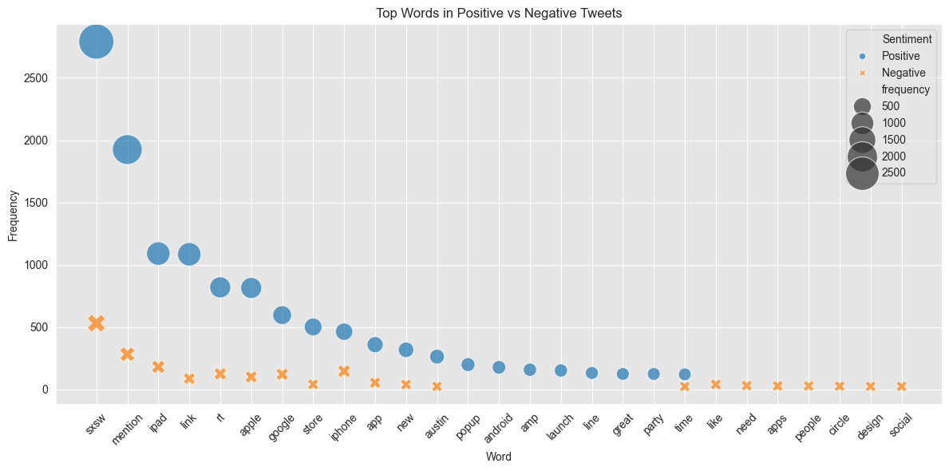
6.3 Recurring themes in positive/negative Tweets (e.g., battery life, design, price)

Slide 11
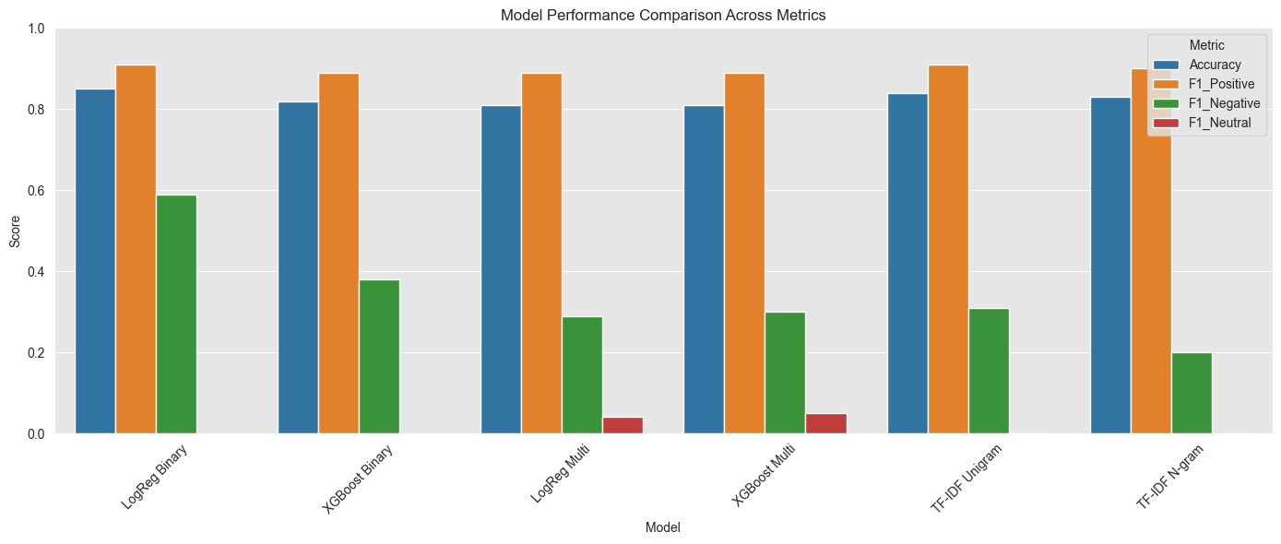
6.4 Effectiveness of an automated classifier in predicting sentiment based on Tweet content

Slide 12
7.1 Conclusion
This project successfully demonstrated the potential of machine learning in classifying public sentiment toward Apple and Google products.
While the model excels at detecting positive sentiment, additional techniques are needed to improve the detection of negative and neutral sentiment.
Future improvements could include more balanced data, context-aware models, and broader data sources for better brand intelligence.

Slide 13
7.2 Recommendations
For Model Improvement:
- Explore contextual embeddings (BERT, RoBERTa)
- Use advanced resampling (ADASYN) or class weighting
For Business Use:
- Monitor iPhone-related tweets for pain points
- Amplify positive themes (e.g., SXSW, store events)
- Deploy real-time sentiment tracking for feedback

